Slide 1
MONEY MATTERS
A PERSONAL FINANCE MANAGEMENT APP

Slide 2
DESCRIPTION
A Personal Finance Management App is a mobile or web-based application designed to help individuals manage their finances more effectively. It provides tools and features to track income, expenses, savings, investments, and financial goals. The goal of such an app is to simplify financial management, provide insights into spending habits, and promote better financial decision-making.
OBJECTIVE:
The Objective of the Personal Finance Management App is to help users take of their financial health by offering an intuitive platform for tracking income, expenses, budgeting, and goal setting. The app aims to simplify money management, provide personalized financial insights, and improve financial literacy,
FUNCTIONALITIES:
The Personal Finance Management App enables users to track expenses, set budgets,
manage financial goals, monitor income and investments, receive personalized insights, and generate reports, all while ensuring secure data protection.
ADDITIONAL REQUIREMENTS:
.The Personal Finance Management App include seamless integration with bank accounts and financial institutions, real-time transaction syncing, multi-platform support (iOS, Android, web), advanced data encryption for security, and a user-friendly interface suitable for all financial literacy levels.

Slide 3
MAIN ACTIVITY:
Import android.annotation.SuppressLint import android.content.Intent
import android.os.Bundle import androidx.activity.ComponentActivity import androidx.activity.compose.setContent
import androidx.compose.foundation.Image import androidx.compose.foundation.layout.* import androidx.compose.material.*
import androidx.compose.runtime.* import androidx.compose.ui.Alignment

Slide 4
import androidx.compose.ui.Modifier import androidx.compose.ui.graphics.Color
import androidx.compose.ui.res.painterResource import androidx.compose.ui.text.font.FontWeight import androidx.compose.ui.text.style.TextAlign import androidx.compose.ui.tooling.preview.Preview import androidx.compose.ui.unit.dp
import androidx.compose.ui.unit.sp
import com.example.expensestracker .ui.theme.
ExpensesTrackerTheme

Slide 5
classmainactivity:
ComponentActivity() { @SuppressLint("UnusedMaterialScaffoldPaddingParameter") override fun onCreate(savedInstanceState: Bundle?) { super.onCreate(savedInstanceState)setContent { Scaffold(
// in scaffold we are specifying top bar. bottomBar = {
// inside top bar we are specifying
// background color.
BottomAppBar(backgroundColor = Color(0xFFadbef4) modifier = Modifier.height(80.dp),
// along with that we are specifying
// title for our top bar. content = { Spacer(modifier = Modifier.width(15.dp)) Button( onClick = {startActivity(Intent(applicationContext,
AddExpensesActivity::class.java))},
colors = ButtonDefaults.buttonColors(backgroundColor = Color.White),
modifier = Modifier.size(height = 55.dp, width = 110.dp)

Slide 6
Spacer(modifier = Modifier.width(15.dp Button(onClick = { startActivity(Intent( applicationContext,SetLimitActivity::class.java))},
colors = ButtonDefaults.buttonColors(backgroundColor = Color.White), modifier = Modifier.size(height = 55.dp, width = 110.dp)) {
Text( text = "Set Limit", color = Color.Black, fontSize = 14.sp, textAlign = TextAlign.Center)} Spacer(modifier = Modifier.width(15.dp))}
Button(onClick = startActivity( Intent ( applicationContext,ViewRecordsActivity::class.java))} colors = ButtonDefaults.buttonColors(backgroundColor = Color.White), modifier = Modifier.size(height = 55.dp, width = 110.dp)){
text(text = "View Records", color = Color.Black, fontSize = 14.sp, textAlign = TextAlign.Center)}}
{Mainpage }}
}
}

Slide 7
@Composable
fun MainPage() { Column(
modifier = Modifier.padding(20.dp).fillMaxSize(), verticalArrangement = Arrangement.Center, horizontalAlignment = Alignment.CenterHorizontally)
{ Text(text = "Welcome To Expense Tracker", fontSize = 42.sp, fontWeight = FontWeight.Bold, textAlign = TextAlign.Center) Image(painterResource(id = R.drawable.img_1), contentDescription ="",
modifier = Modifier.size(height = 500.dp, width = 500.dp)) } }

Slide 8
OUTPUT :

Slide 9
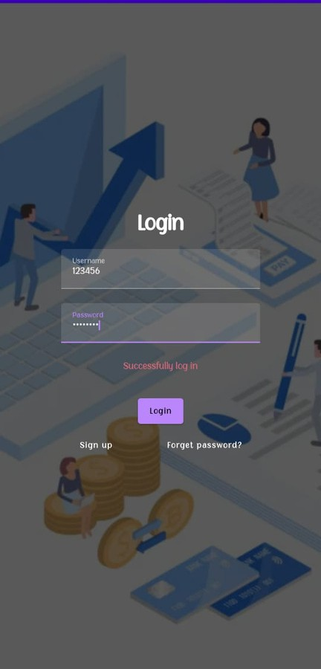

Slide 10
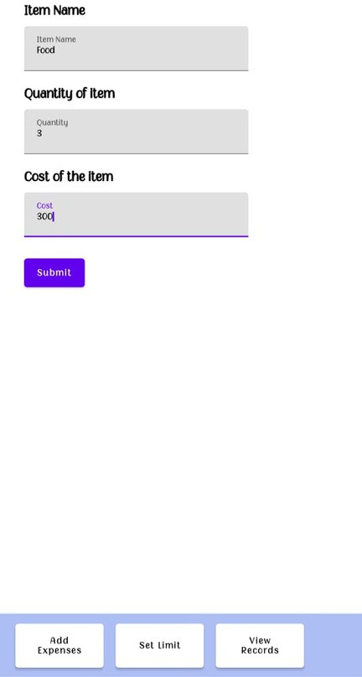

Slide 11
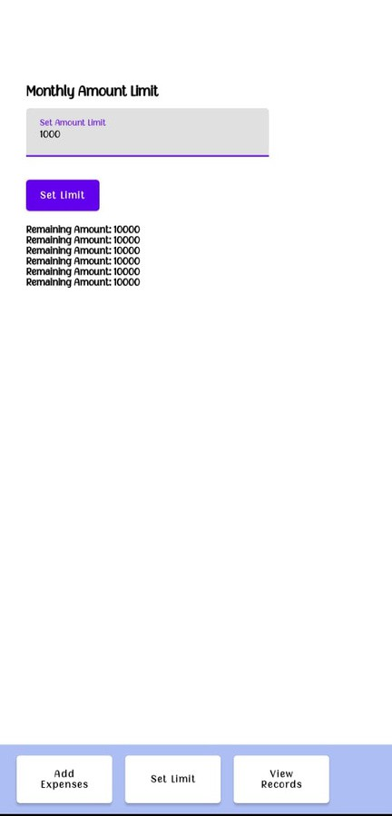

Slide 12
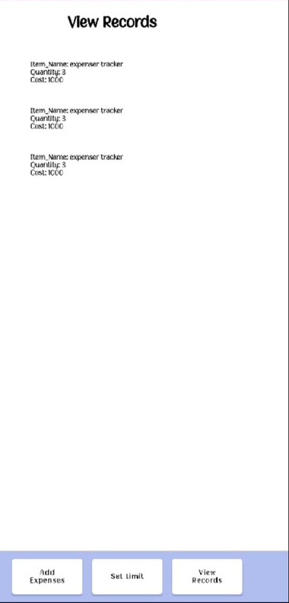

Slide 13
